Slide 1
Attention, the Origin of Pose
The ability to focus on prey or predator wired our brains for pose.

Slide 2
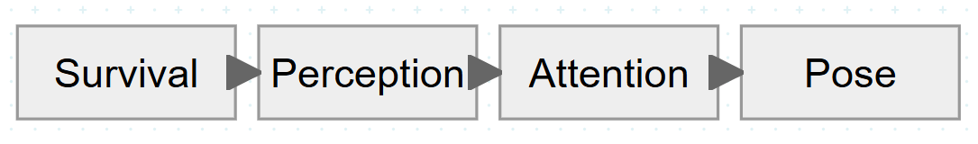
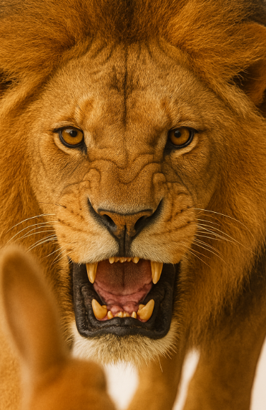
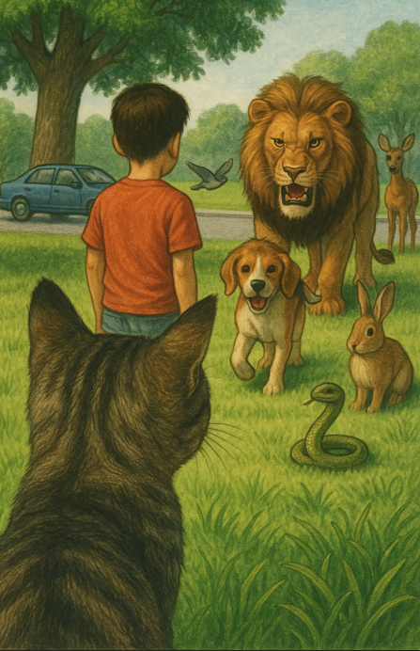
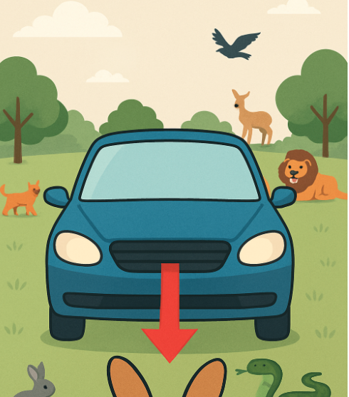
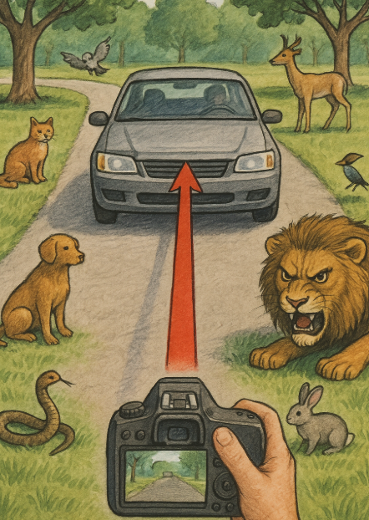
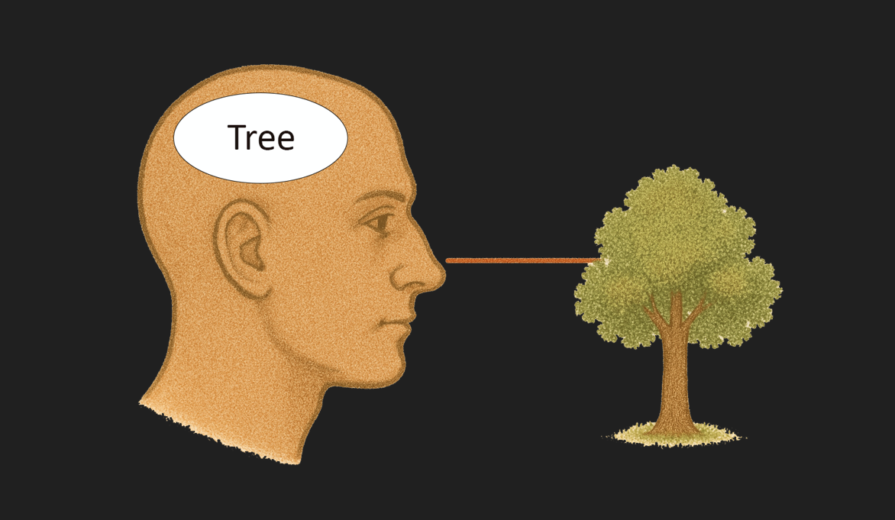
TLDR

Slide 3
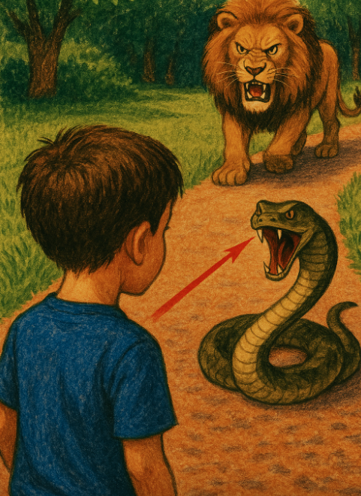
Survival
Many animals use vision to help them catch prey, find mates, or defend against danger. The ability to focus enables them to detect, locate, and orient themselves to food or danger. Evolution has wired attention into their brains.
We humans conceptualize this attention as perception of the location and orientation of ourselves or of tasty or scary things that we can see.
This visual attention to a perceived reward or threat we call “focus” or “gaze”.

Slide 4
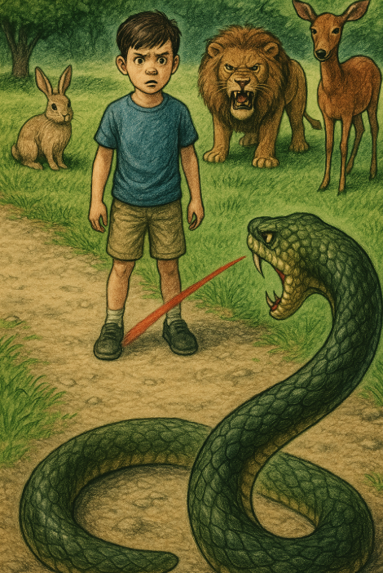
Visual Perception
The human has both limited visual acuity and limited ability to think about objects in different reference frames at the same time.
Much of the time, the gaze jumps around in order to project the most important part of the scene on the densest area of retinal receptors. Our wiring blanks out the jumps and stitches the sensed views into a perception of the external environment, focussing attention on recognized objects.

Slide 5
Visual Perception
Our visual perception produces a simplified internal representation, focussed on one Subject.
We maintain the illusion that we are looking at many things simultaneously.

Slide 6
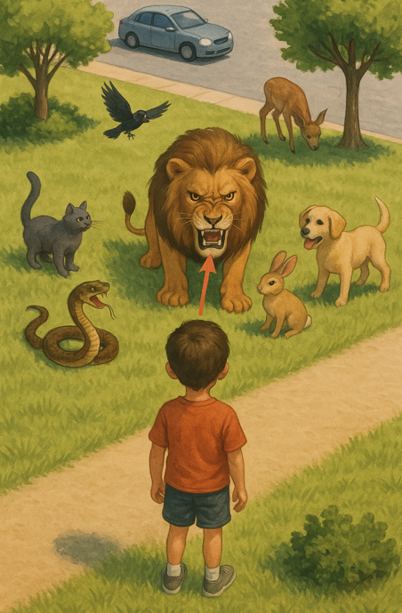
Perception Is Selective
This Boy creates a simplified internal representation.
Lion - very dangerous
Snake - dangerous
Rabbit, Dog, Cat, Bird
Deer, Lawn, Bush
Footpath, Footpath
Car, Driver, Tree, Tree, Bush, Street
He attends to the Lion and may be aware of the Snake.

Slide 7
Attention
All of the sentient beings (Observers) perceive and are attending to the Boy (Subject). Each has established a reference frame, centred on their visual system and oriented toward the Boy. This relationship between Observer and Subject is a Pose. A Pose is a simple and direct way to express an attention relationship, visually perceived in the scene.
Example Pose description: The Lion is 3 m in front of the Boy, looking at him.

Slide 8
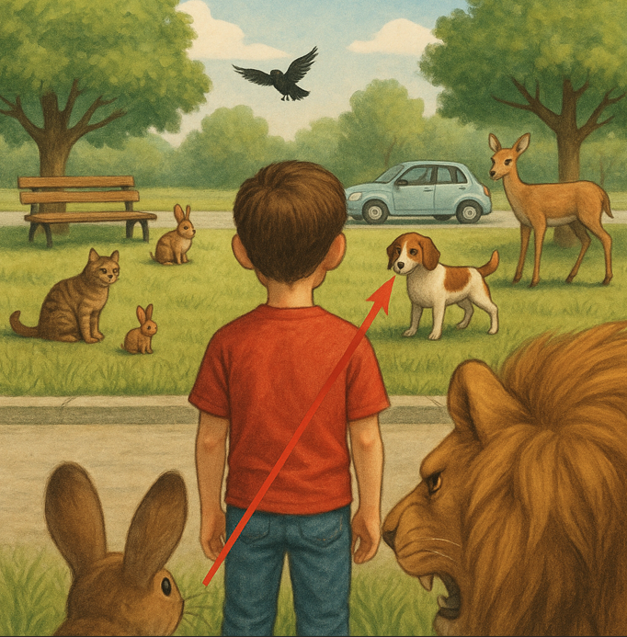
Attention and Pose
Here, the Rabbit (Observer) is attending to the Dog (Subject) while the Lion (Observer) is attending to the Rabbit (Subject). Some objects cannot pay attention (Tree) and some are controlled by an Observer (Car).
Each Observer can fully attend to only one detected Subject at a time. Posed attention limits global awareness but we normally do not realise this effect of focus.

Slide 9
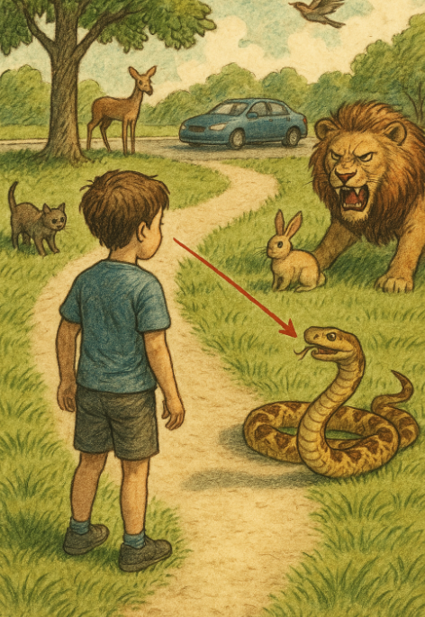
Translation-Orientation Model
Pose is an abstraction of the concept of an Observer’s attention to a visually detected Subject.
One way to express Pose is to start with a geometrical model.
Step 1:
Transform the “centre of visual perception” to a external 3D coordinate system (Translation).
Step 2:
Orient the coordinate system to the direction of attention (Orientation).

Slide 10
Adding Depth
A Pose by itself, defines a ray somewhere along which a Subject of interest lies.
Adding the distance along the ray, from Observer to Subject, or Depth, gives the Position of the Subject,
(Optional) Step 3:
Determine the distance along the direction of attention from the centre of visual perception to the Subject (Depth).
This step requires extra information that is often unavailable.

Slide 11
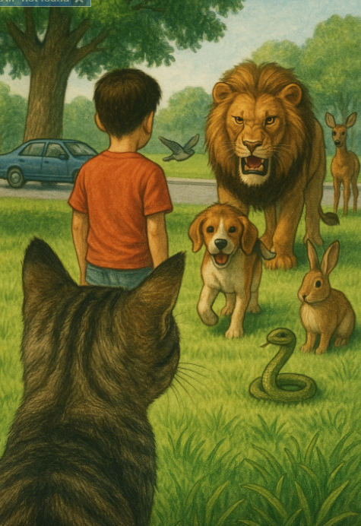
Three Types of Pose
Observer Pose - the position and orientation of an imaging sensor or animal visual perception system.
Subject Pose - the orientation of a ray in the direction of a recognized viewed object (Subject) from the location of an Observer
Object Pose - the position and orientation of an object. Not every semantic type has an orientation independent of an Observer.

Slide 12
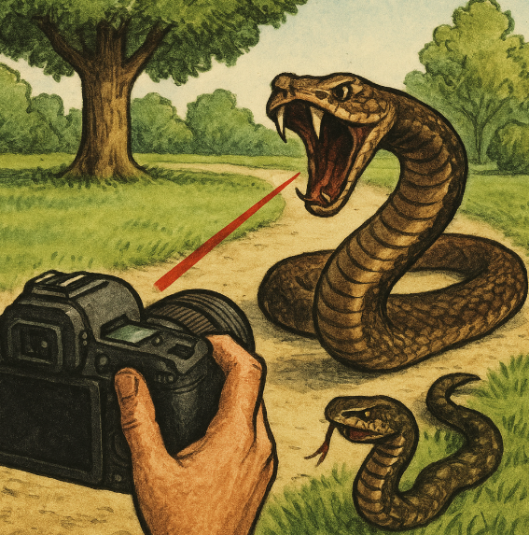
Observer Poses
An Observer Pose is defined by the position of a visual system centre or an imaging sensor’s centre and the Orientation or direction of view.
Observer Poses are independent of the environment. They do require some natural orientation of the Observer. The ocean or a tree are examples that do not. They do not have an Observer Pose.

Slide 13
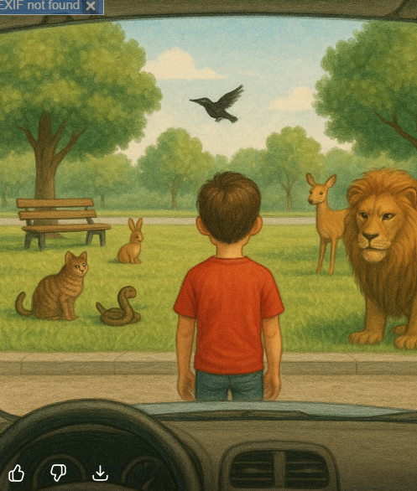
Subject Poses
A Subject Pose is defined by the position of a detected object with respect to a visual system’s Orientation or direction of view.
In this scene, the centre of the visual system is in the Car and oriented toward the Boy. There are other detected objects in the scene (Bench, Bird, Tree…) that have the same centre but a different orientation. Those different orientations define a set of Subject Poses.

Slide 14
(Detected) Object Poses
Objects have different semantic types when perceived by humans or detected by neural network models. Some semantic types have a natural structure that gives them both position and orientation - a natural or intrinsic Pose.
If an Observer can detect the natural Pose of an object (left car) while the Observer has a view of the object (right car) as a Subject, the object will have two different Poses at the same time.

Slide 15
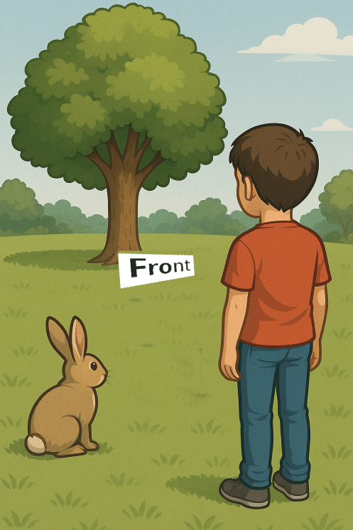
(Induced) Object Poses
Some semantic types do not have a natural structure that enables them to have a corresponding natural or intrinsic Pose.
For example, a Tree or a Rock does not have a Pose.
An Observer can induce an Orientation, based on the direction toward the observer. This induced Object Pose is only meaningful when the Observer position is also specified.

Slide 16

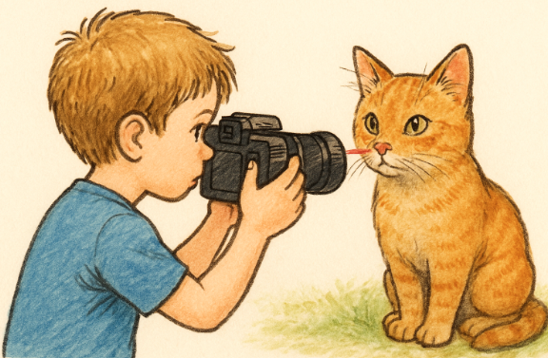
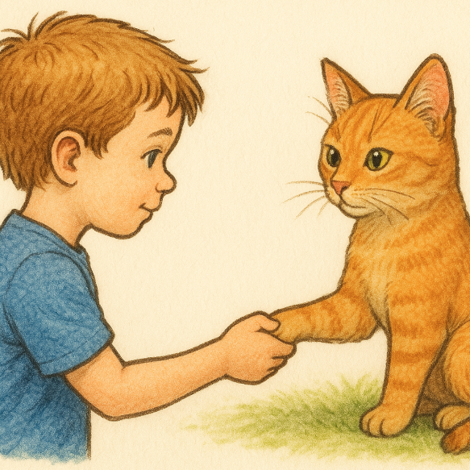
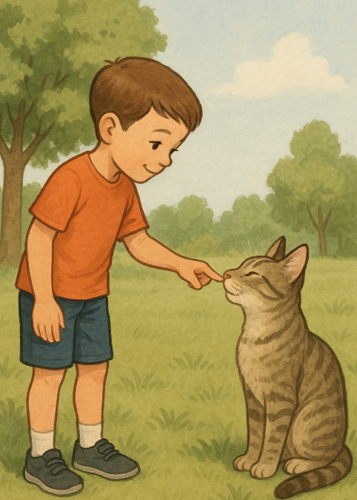
Four Abstract Use Cases
There are four stereotypical use cases where a construct related to pose appears:
pointing,
posing,
touching, and
connecting.
These involve different degrees of freedom – specification of parameters – and reflect the application with visual or instrumented sensors.

Slide 17
Why Are the Use Cases Important?
The use cases represent the ways humans (and automata) use poses and related constructs in practice.
For example, many uses assume that one direction of orientation is defined, for example
a horizontal plane orthogonal to the direction of gravitational acceleration. In this case, there are only two degrees of orientational freedom: altitude and azimuth, for example.

Slide 18
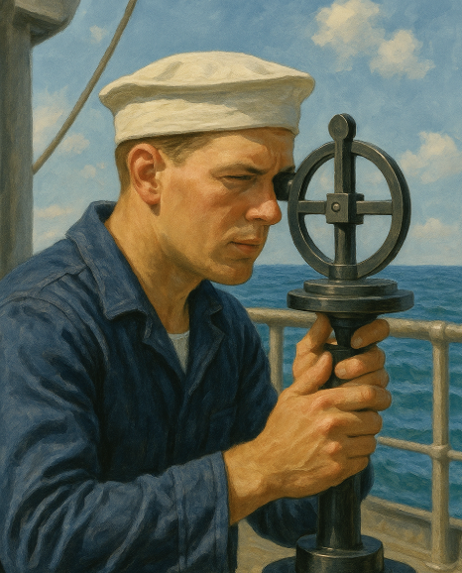
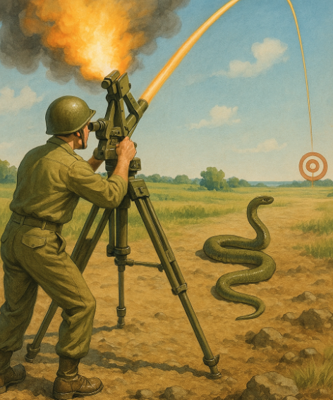
Pointing
Pointing defines fewer than 3 degrees of freedom in orientation.
For example, at sea, where the interesting things are constrained to the sea surface, a single angle – a bearing – is enough: 4 degrees of freedom.
Sometimes two angles – an azimuth and an altitude, for example – can be specified: 5 degrees of freedom altogether.
Point with 6 degrees of freedom specified is posing.

Slide 19
Posing
Posing completely specifies the origin and orientation of a local Cartesian coordinate system.
A GeoPose relates the local coordinate system to an externally define 3-dimensional coordinate system.
Even though pointing and posing are closely related, many practical use cases are defined by the number of unconstrained degrees of freedom in orientation.
Posing has 3, and corresponds to the computer graphics pose concept.

Slide 20
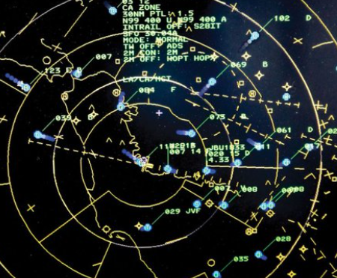
Touching
Touching is posing plus a distance from the origin of the local coordinate system to a distinguished point on the subject.
Sensor systems such as RADAR and LiDAR naturally estimate a combined pose and
range (depth). Robotic systems may use binocular vision to estimate depth.
Artificial visual perception may produce a field of touch points – a depth map. A depth map is often produced by visual positioning systems.

Slide 21
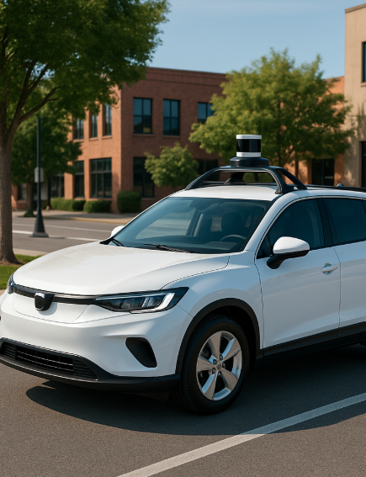
Connecting
Connecting is the combination of posing plus a depth.
Autonomous navigation and robotics with direct manipulation of objects in the world are examples.
Connecting often involves a chain or graph of poses to meet the requirements of practical use cases.

Slide 22
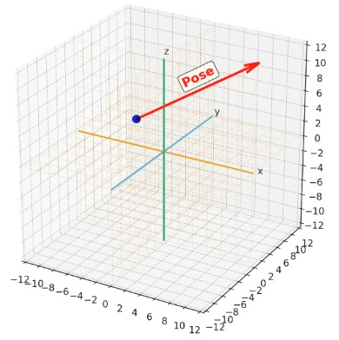
Representing a Pose
Poses have an origin and a direction. You can represent a Pose as a unit vector in a 3D (Euclidean) space.
In practice, a Pose may have additional properties:
The type of Pose - Observer, Subject, or Object.
One or more depths.
An associated uncertainty.
A time.
An identifier.

Slide 23
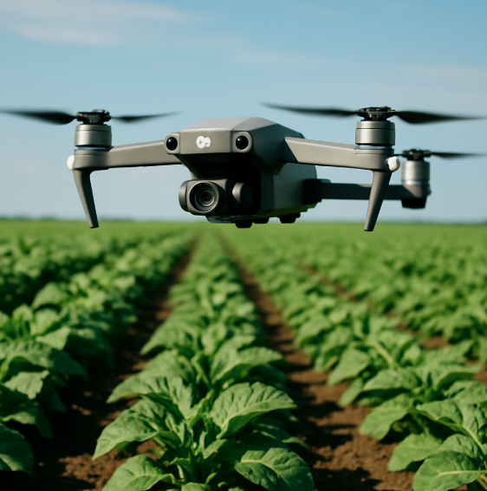
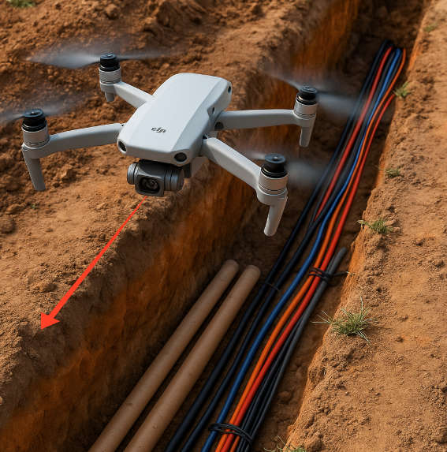
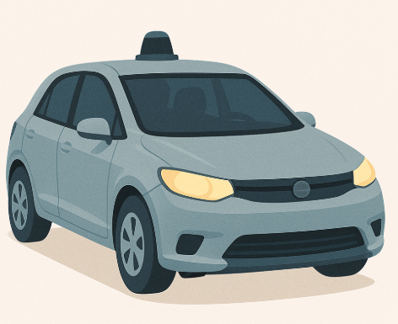
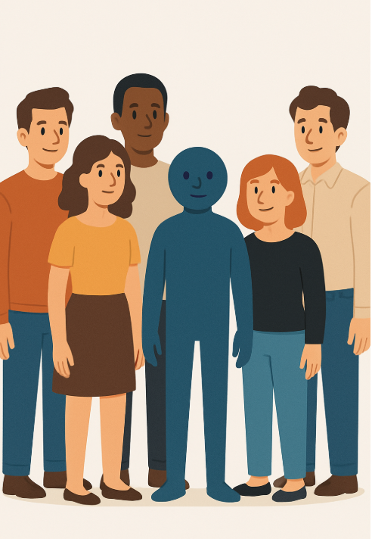
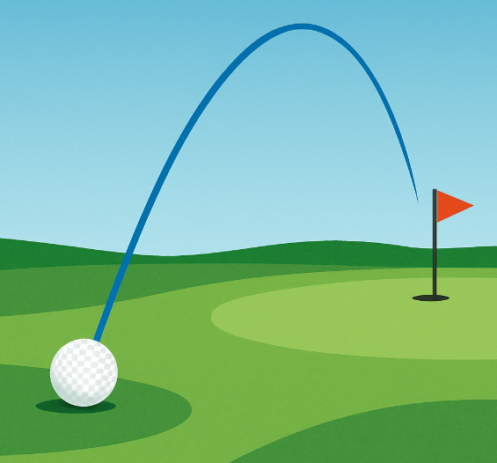
Using Poses
There is a wide range of applications. Most automate attention-intensive monitoring of human activities. The final presentation in this series covers applications that fall within the domain of artificial perception:
Surveillance, Reconnaissance, and Navigation
Collision Avoidance and Threat Prediction
Crop Inspection
Autonomous Vehicles
Environmental Inventory and Monitoring
Tracking
Privacy Protection - Avatar Substitution

Slide 24
References: Overview
Lima & Dill (1990). Classic review of decisions under predation risk; frames the vigilance–foraging trade-off. gambusia.zo.ncsu.edu
Lima & Bednekoff (1999/2009). Risk Allocation Hypothesis and later reassessment; when prey should shift attention across fluctuating danger. CellScienceDirectjstor.org
Laundré et al. (2010); Palmer et al. (2019); Gaynor et al. (2017). “Landscape of fear” concept and updates—spatial patterns of perceived risk shaping posture/vigilance and space use. predatordefense.orgScienceDirectpeerj.com
Brown (1988). “Giving-up densities” (GUD): patch-leaving as a readout of foraging vs. fear costs. SpringerLink
Stephens & Krebs (1986). Foraging Theory (monograph) — core models behind attention to food vs. danger. books.google.com
Brown & Kotler (2004). “Hazardous duty pay” review—quantifying the foraging cost of predation. Wiley Online Library
Kotler et al. (2006). Meta-analysis using GUDs to measure fear–foraging trade-offs. SpringerLink

Slide 25
References: Vigilance in Groups
Elgar (1989). Critical review of the group-size effect on vigilance. findanexpert.unimelb.edu.au
Quenette (1990). Functions of vigilance in mammals—predator detection, monitoring conspecifics, food location, kleptoparasitism avoidance. ResearchGate
Beauchamp (2008, 2021). Meta-analyses (birds; then mammals) quantifying how vigilance scales with group size and context. academic.oup.com+1
Rodríguez-Gironés & Vásquez (2002); Roberts (1996). Mechanisms behind the group-size effect & “many-eyes/dilution” hypotheses. ScienceDirectfaculty.washington.edu
Bednekoff (2015); Hollen et al. (2010). Reviews/empirical work on sentinel systems in birds & mammals, including coordination by calls. SpringerLinkPLOS
Ridley et al. (2013); Wright et al. (2001). Are sentinels “safe/selfish”? Tests in pied babblers and other cooperative species. ScienceDirectbesjournals.onlinelibrary.wiley.com

Slide 26
References: Pose and Vision
Fernández-Juricic et al. (2012). Sensory basis of vigilance—how visual fields drive scanning/head movements. ScienceDirect
Jones et al. (2007); Bergman & Beauchamp (2011). Head-movement rate (not just scan duration) as a key posture-based vigilance metric; peripheral individuals turn heads more. ScienceDirect+1
Fernández-Juricic et al. (2009/2010). Visual field configuration predicts predator-detection postures and head orientation in birds. academic.oup.comScienceDirect
Typology papers describing “head-up” vigilant postures (e.g., wild boar) useful for pose scoring in the field. etoecoevo.org

Slide 27
References: Gaze Following
Emery (2000); Shepherd (2010). Reviews of social gaze across vertebrates and its evolutionary role. ece.uvic.caFrontiers
Bugnyar et al. (2004–2007); Bugnyar & Heinrich (2006). Corvids follow gaze (even around barriers) and manipulate others’ attention around food caches. ScienceDirectResearchGate
Amici et al. (2020). Gaze following in ungulates—extending beyond primates/birds. Frontiers
Rosati et al.; Kano et al. (2025). Newer work showing pigeons follow conspecific gaze; group context matters. ScienceDirect
Gaze sensitivity review (2013)—how animals learn to use gaze for locating food or avoiding predators. ScienceDirect

Slide 28
References: Eye Tracking
Yorzinski & Platt (2014). Telemetric eye-tracking in peafowl during predator detection—direct readout of visual attention. Yorzinski Lab
Yorzinski et al. (2013/2014/2015). What females actually look at in courtship; coupling of eye and head movements. journals.biologists.compatricellilab.faculty.ucdavis.eduResearchGate
eLife reviewed preprint (2024). Fine-scale tracking in pigeons links foveal use to faster escape—bridging pose to attention. eLife

Slide 29
References: OGC GeoPose
The OGC GeoPose 1.0 Data Exchange Standard is an OGC Implementation Standard, approved on June 20, 2022, and published on September 8, 2023 geopose.org+14docs.ogc.org+14medium.com+14.
It is designated as OGC Doc No. 21-056r11 docs.ogc.org+2ogc.org+2.
The standard defines an interoperable way to express and exchange the location and orientation (poses) of real or virtual geometric objects in geographic reference frames (Earth or astronomical coordinate systems) github.com+13ogc.org+13ogc.org+13.

